Slide 1
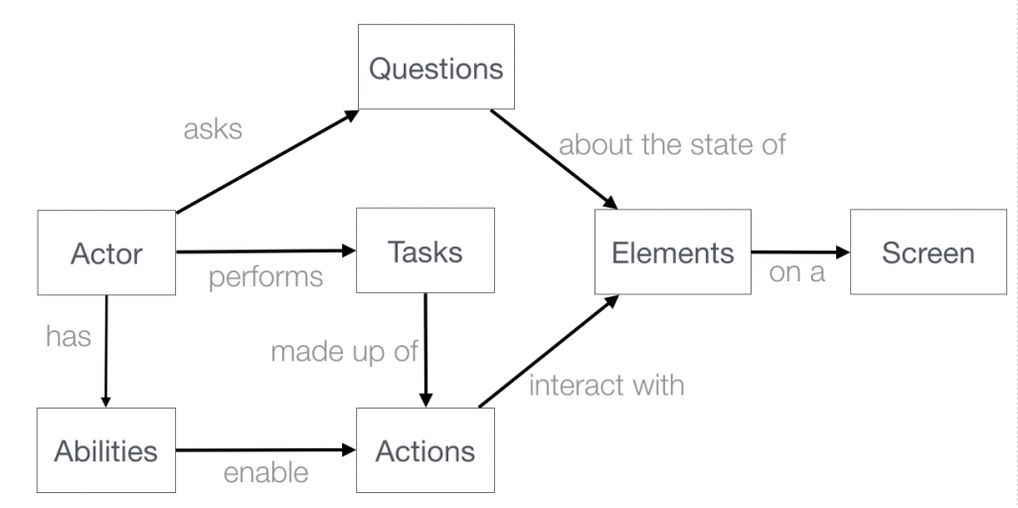
https://www.youtube.com/watch?v=Ptg5NICosNY&t=3977s
Facts
Enable
Learns / Remembers

Slide 2
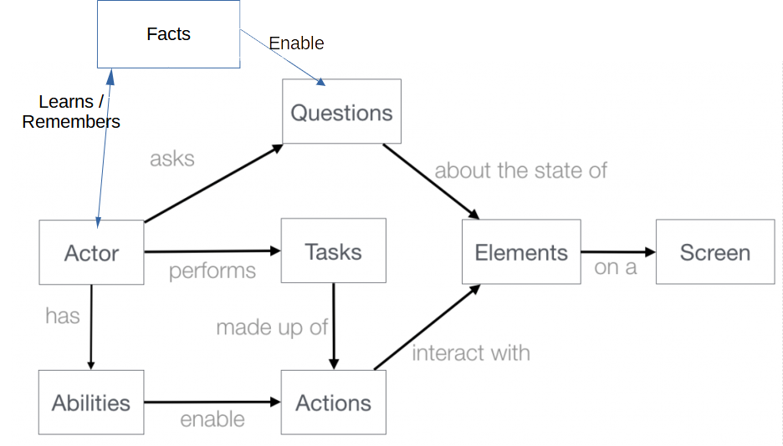
GIVEN <actor 1> who has <facts>
WHEN <actor 1> tries to <tasks> by doing <action>
THEN <actor 1> will be able to <question> thanks to <element> found on <screen>
GIVEN <the_Customer> who has <a_cart>
WHEN <the_Customer> tries to <order> by doing <the_checkout>
THEN <the_Customer> will be able to <check_the_order_is_paid_by_looking> thanks to <the_invoice> found on <the_mailbox>
GIVEN <the_Customer> who has <an_email_address>
WHEN <the_Customer> tries to <sign_up> by doing <registering_to_the_system>
THEN <the_Customer> will be able to <check_the_registration_succeeded> thanks to <the_homepage> found on <the_browser>

Slide 3
Question
Ability
Fact
A_cart
Check_the_registration_succeeded
Check_the_order_is_paid_by_looking
An_email_address
Element
Actor
- peek()
- poke()
Action
The_homepage
The_invoice
The_Customer
The_checkout
Task
Registering_to_the_system
Order
Sign_up
Screen
The_mailbox
The_browser

